Slide 1
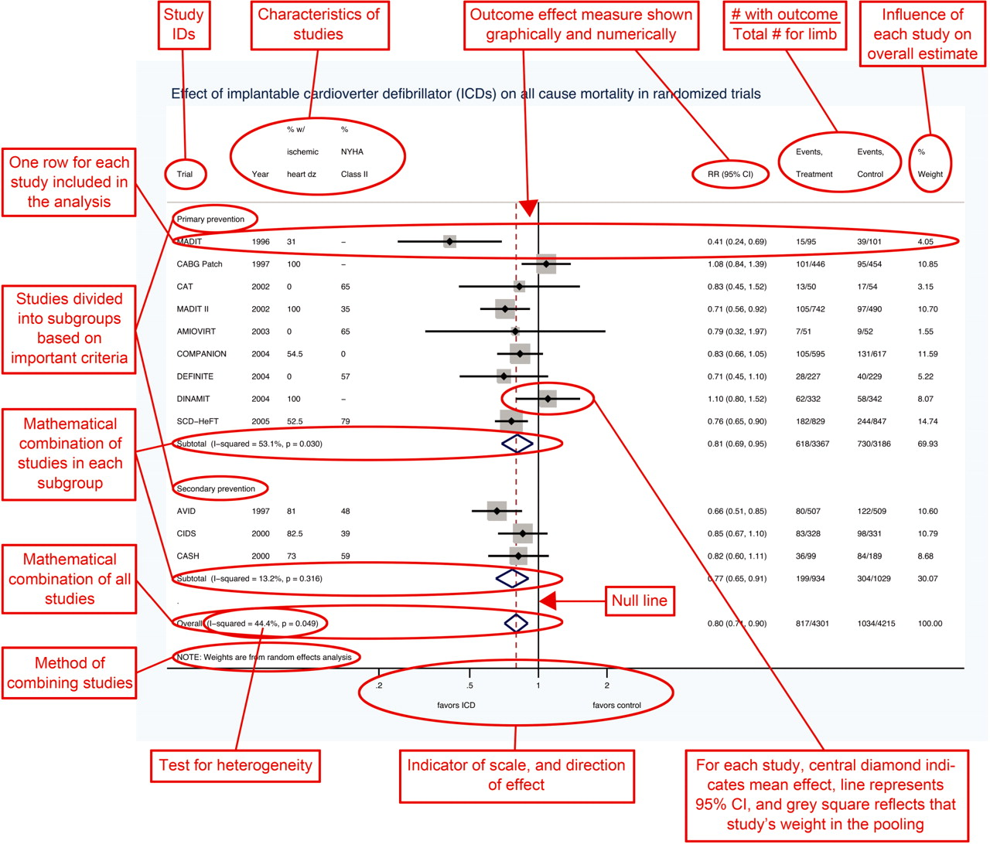

Interpretando um gráfico de forest plot de uma metanálise
David L Schriger et al. Int. J. Epidemiol. 2010;39:421-429
Int. J. Epidemiol. 2010 Apr 39(2) 421-9, Figure 1
Published by Oxford University Press on behalf of the International Epidemiological Association © The Author 2010; all rights reserved.
Notes:
The plot is drawn in STATA 11 (Stata Corp., College Station, TX, USA) from data presented in Ezekowitz et al.22 Note that studies have been sorted first by whether they addressed primary or secondary prevention and second by year of publication. This organization allows readers to easily determine whether they believe that these variables affect the outcome.

